Slide 1



Slide 2

Dredge!
Bridging the gap among Cloud Engineers and Incident Responders with Open Source

Slide 3
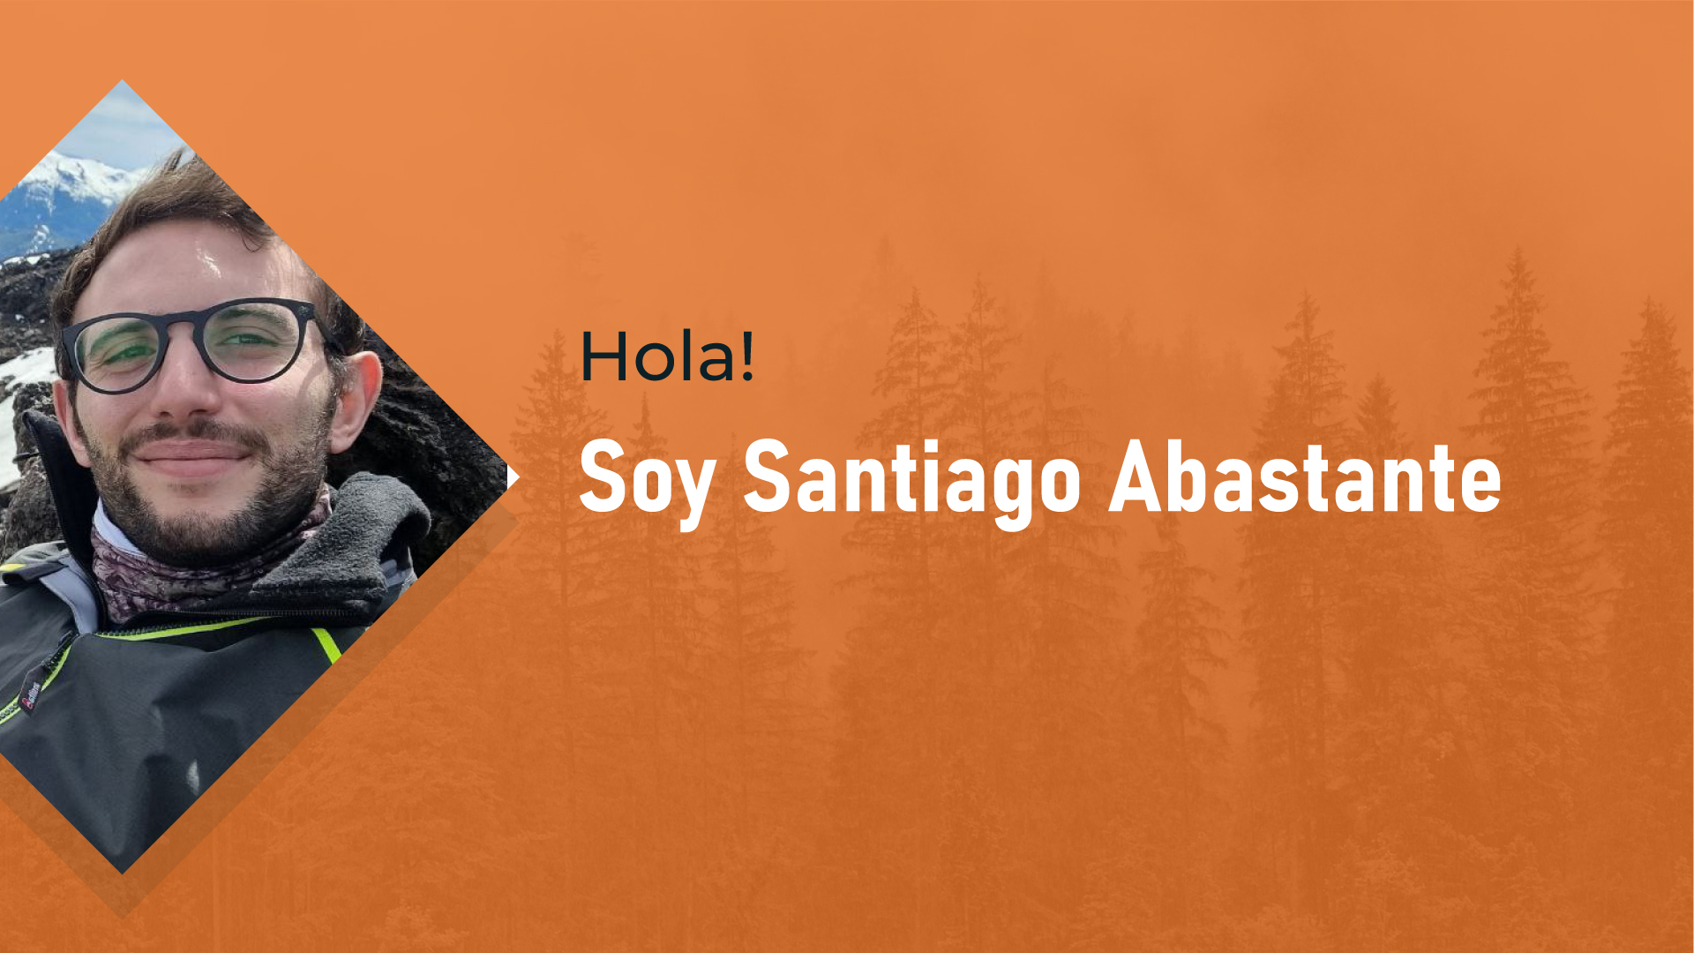
Ex-Police Officer and Cloud Incident Responder with 10+ years of IT experience.

Slide 4



The Incident

Slide 5


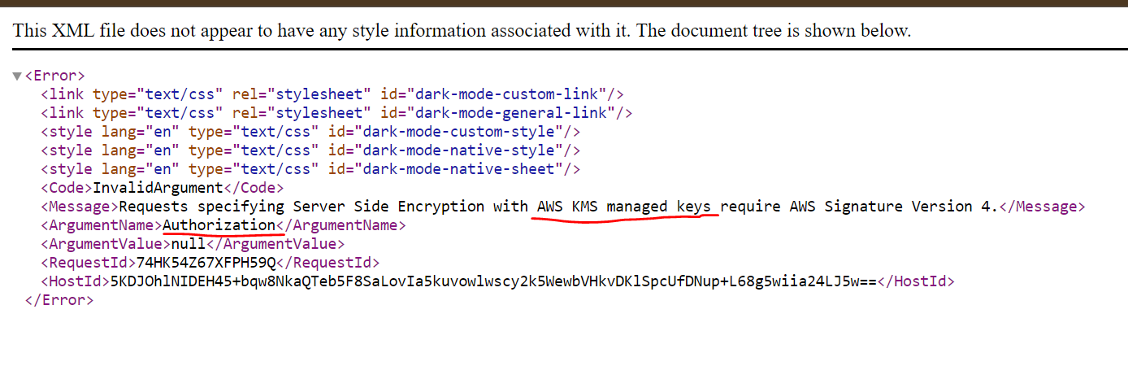
Static Web Hosting… Encrypted!

Slide 6
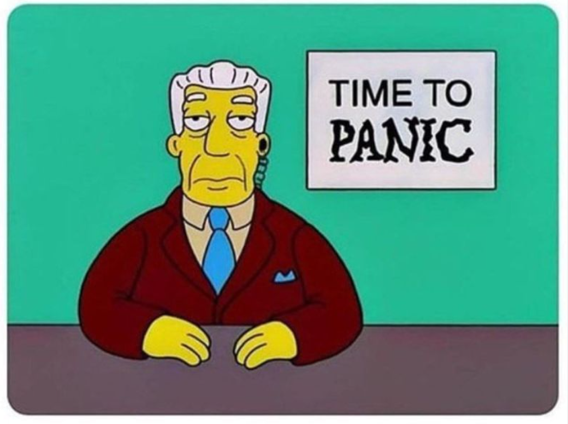
Security Detection’t

Slide 7
Why Dredge

Slide 8
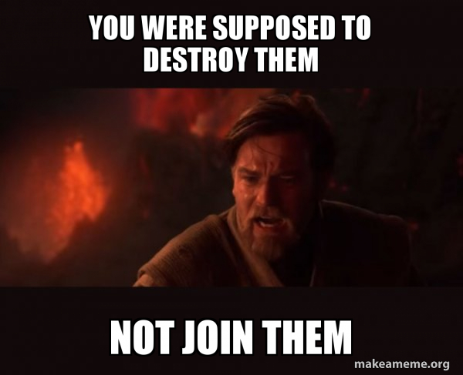

Slide 9
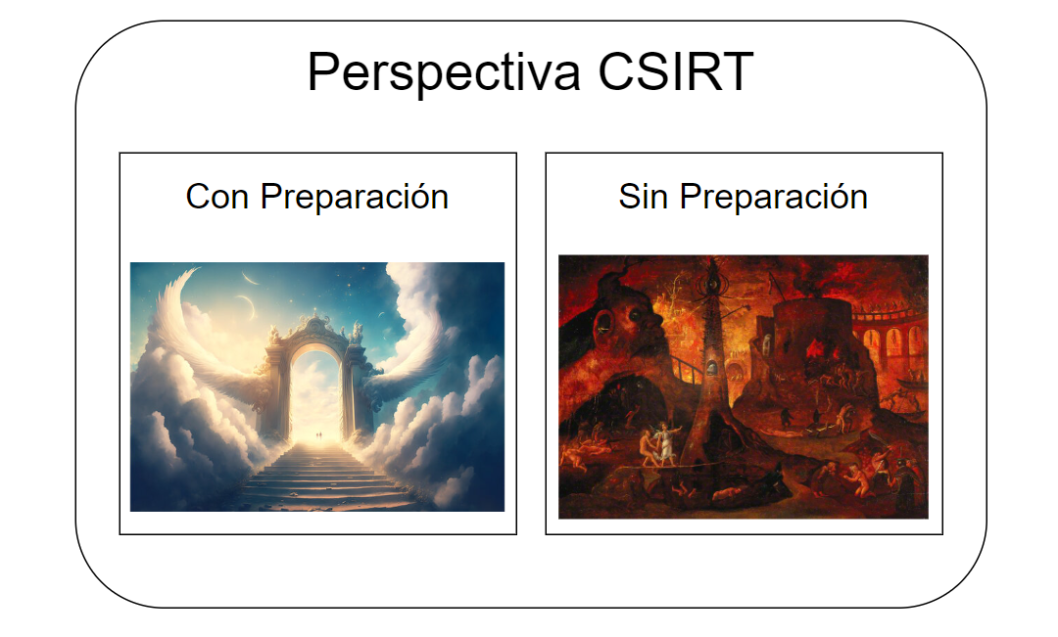

Perspectiva desde un CSIRT

Slide 10
Perspectiva y falsa hipótesis en un IR
Tenemos un ataque y sabemos donde buscar los logs.
Tenemos un ataque y sabemos donde buscar.
Tenemos un ataque y sabemos.
Tenemos un ataque
Tenemos un ataque?
Qué Tenemos?

Slide 11
La problematica del Talento
Para hacer IR en Cloud necesitamos personas que capacitadas en:
Cloud Architecture / Engineering
Cloud Security
Security Engineering
Incident Response
MUCHOS SOFT SKILLS
Paciencia
Poder trabajar en entornos donde reina el caos
Paciencia
Ganas de ser despertado a las 2 am un sábado
Entre otros

Slide 12
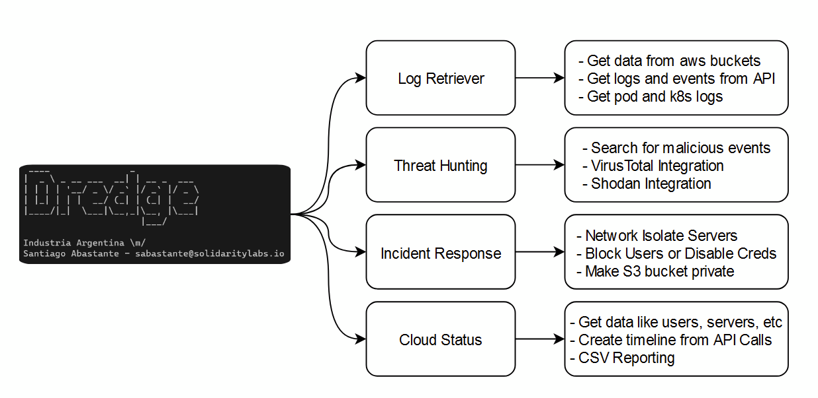

Slide 13
Demo!
Setting Up Dredge

Slide 14
The Investigation

Slide 15
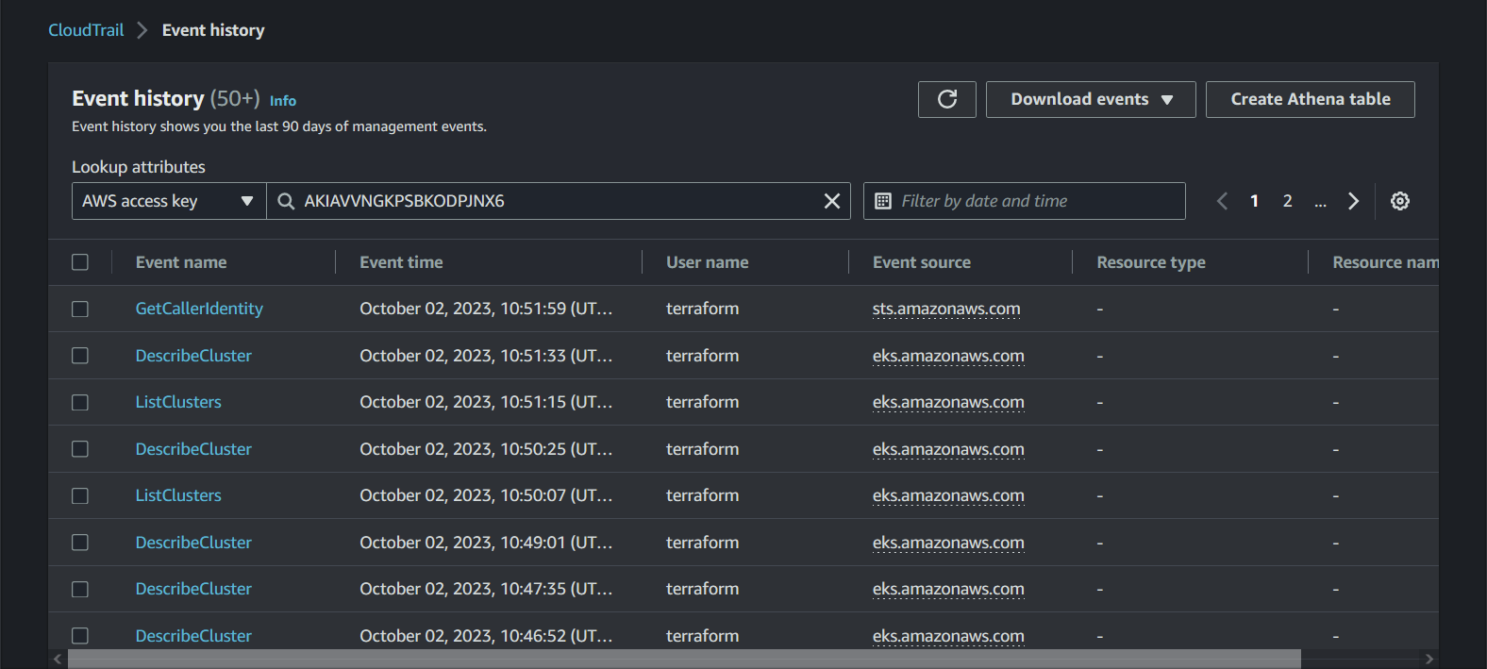
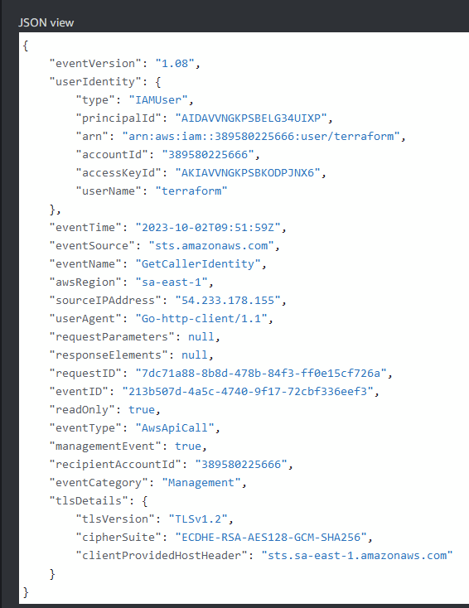
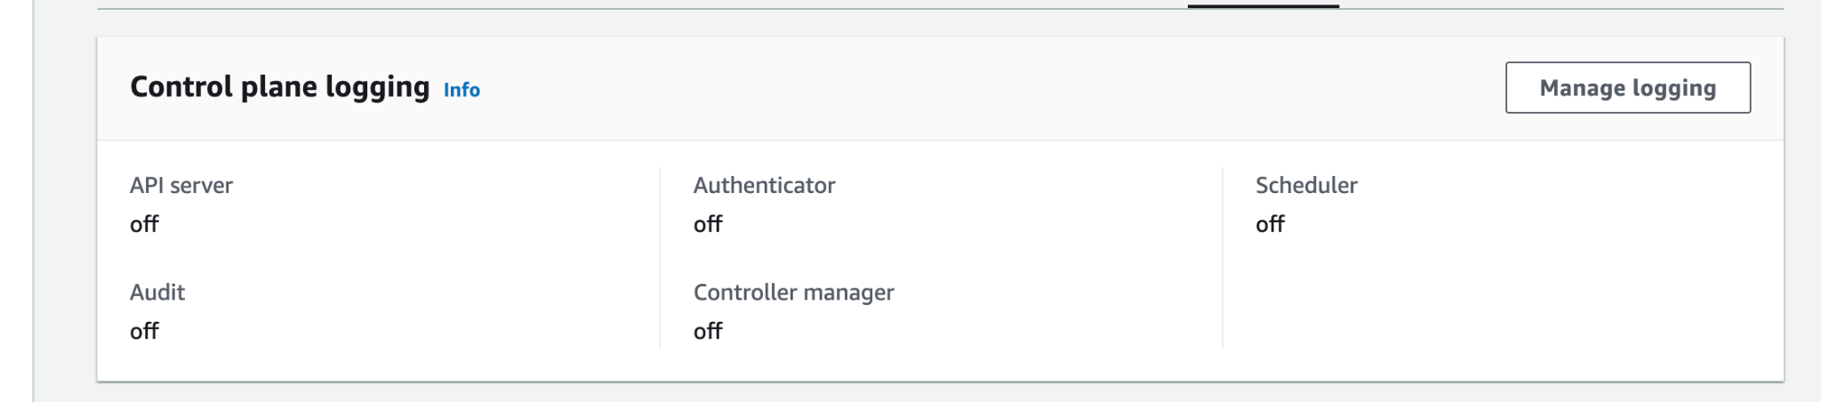
Logging and Monitoring

Slide 16
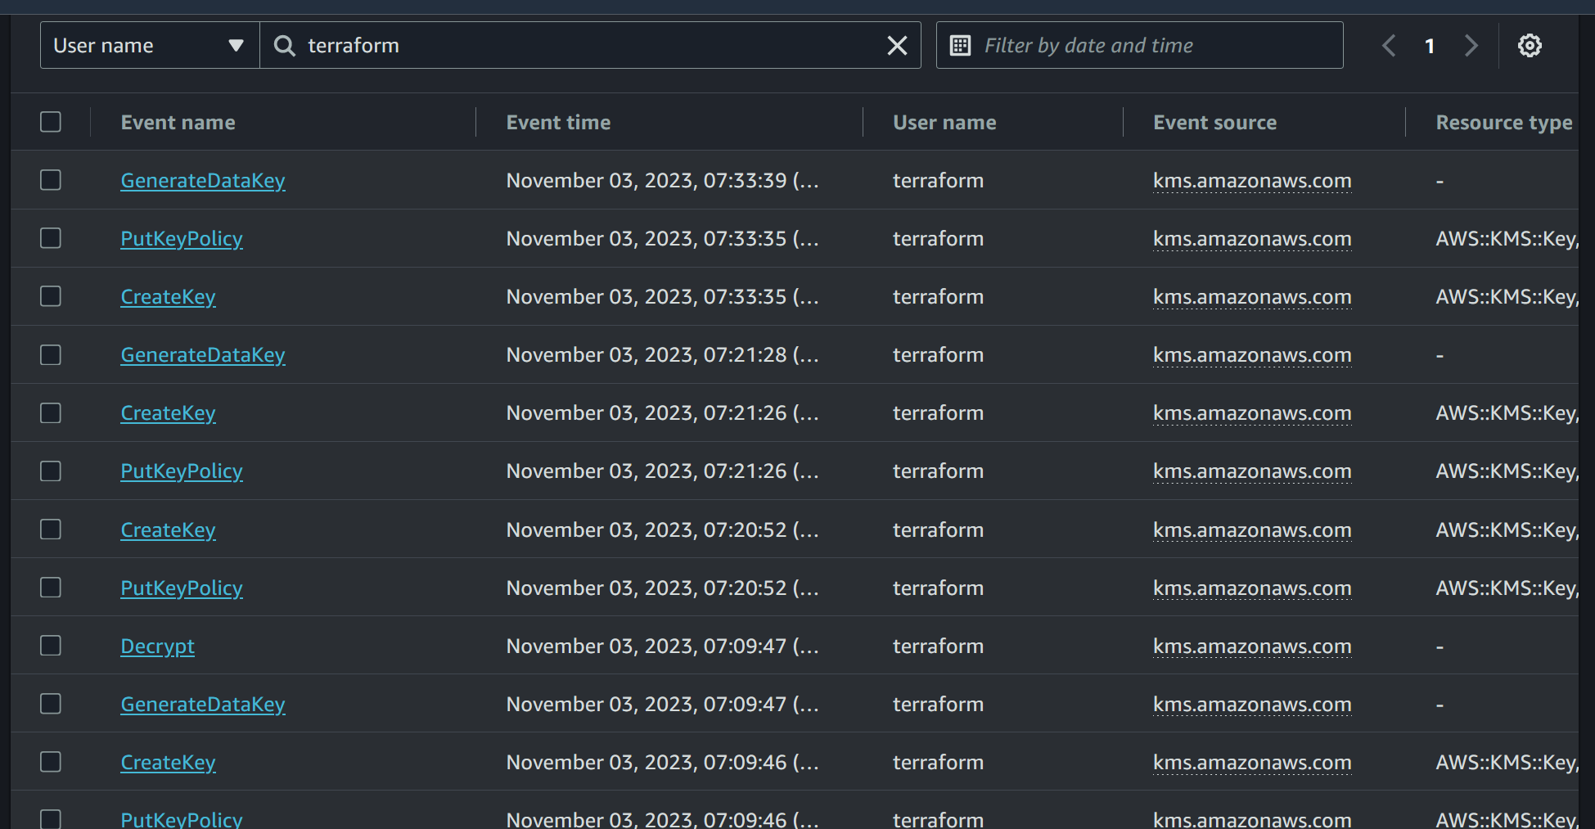
Event History API Logs

Slide 17
Demo!
Getting API Logs from IAM User

Slide 18
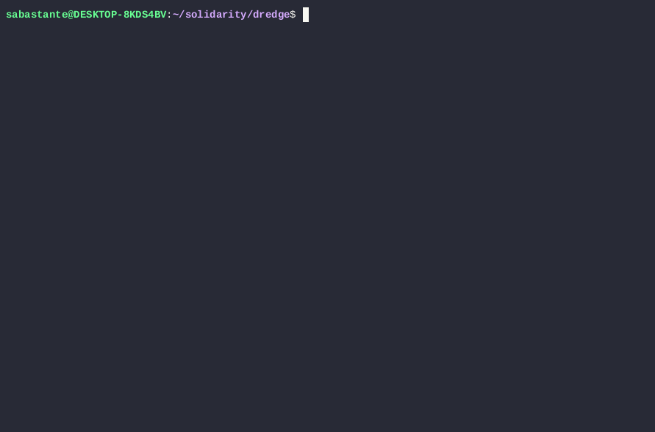

Slide 19
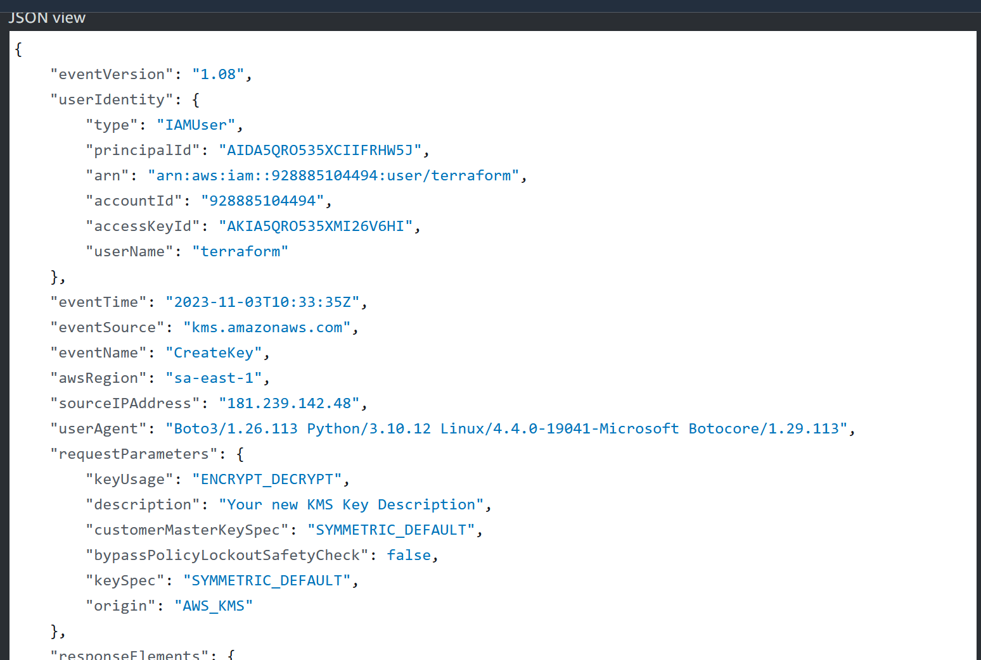
Context: Cloudtrail API Call

Slide 20
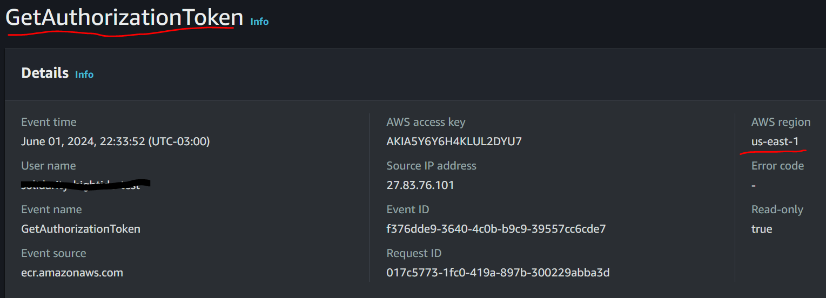
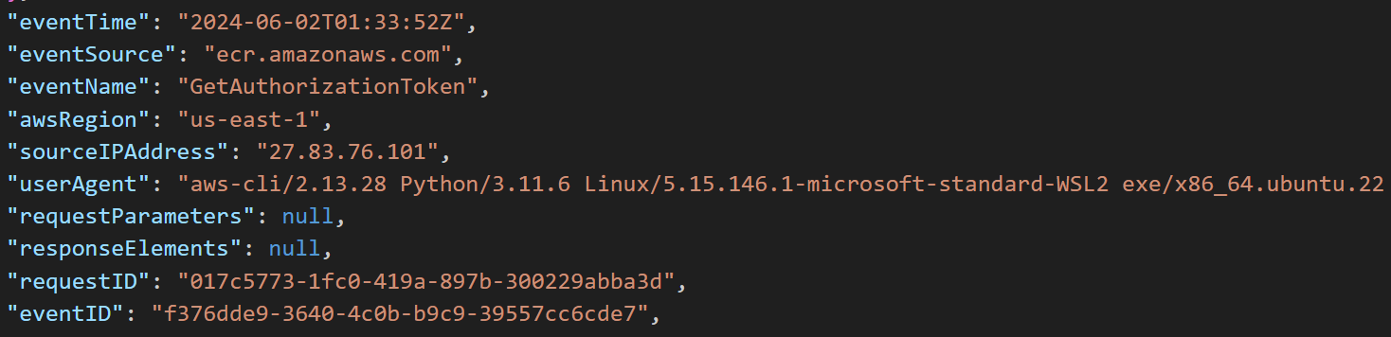

Slide 21
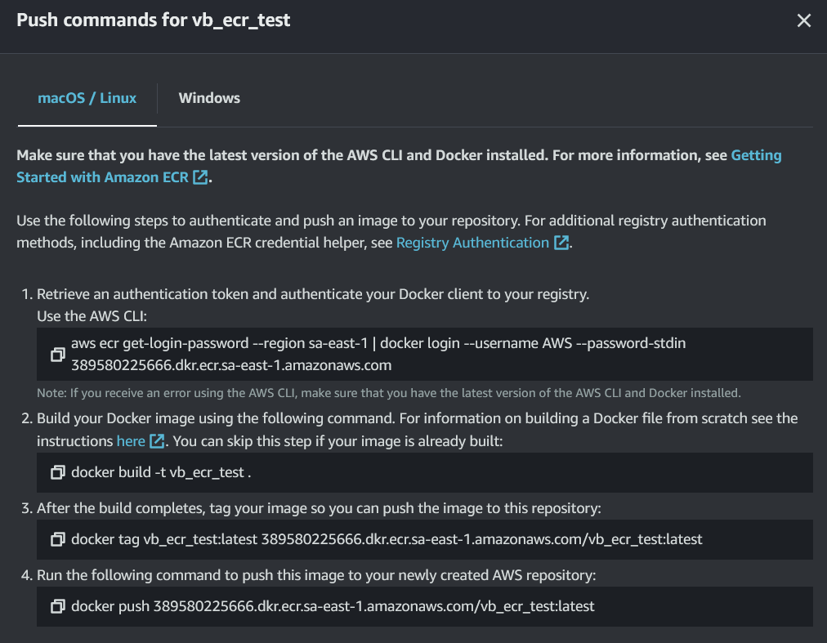
AWS ECR

Slide 22
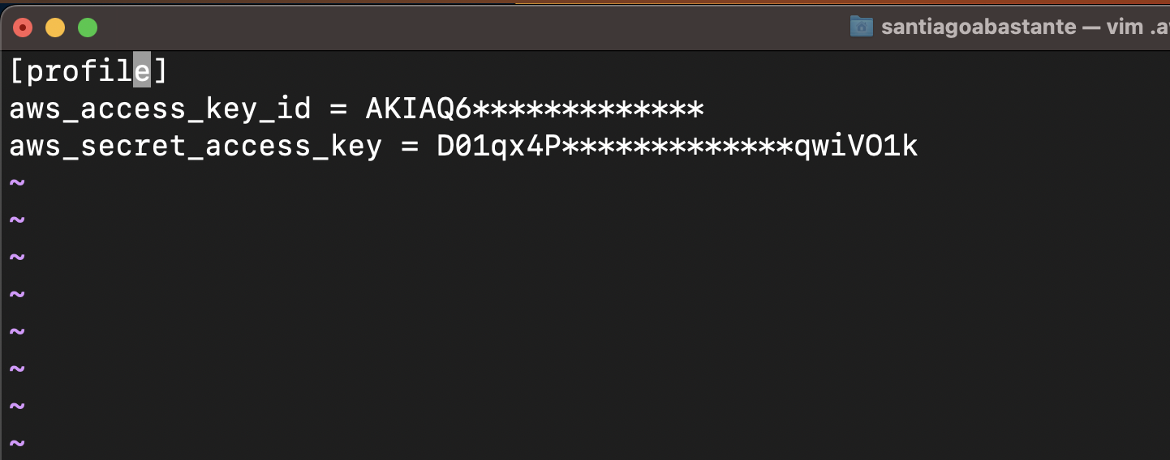
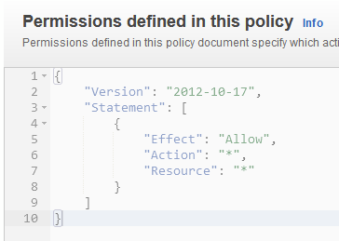
Context: AWS IAM

Slide 23
Demo!
Getting IAM Users

Slide 24
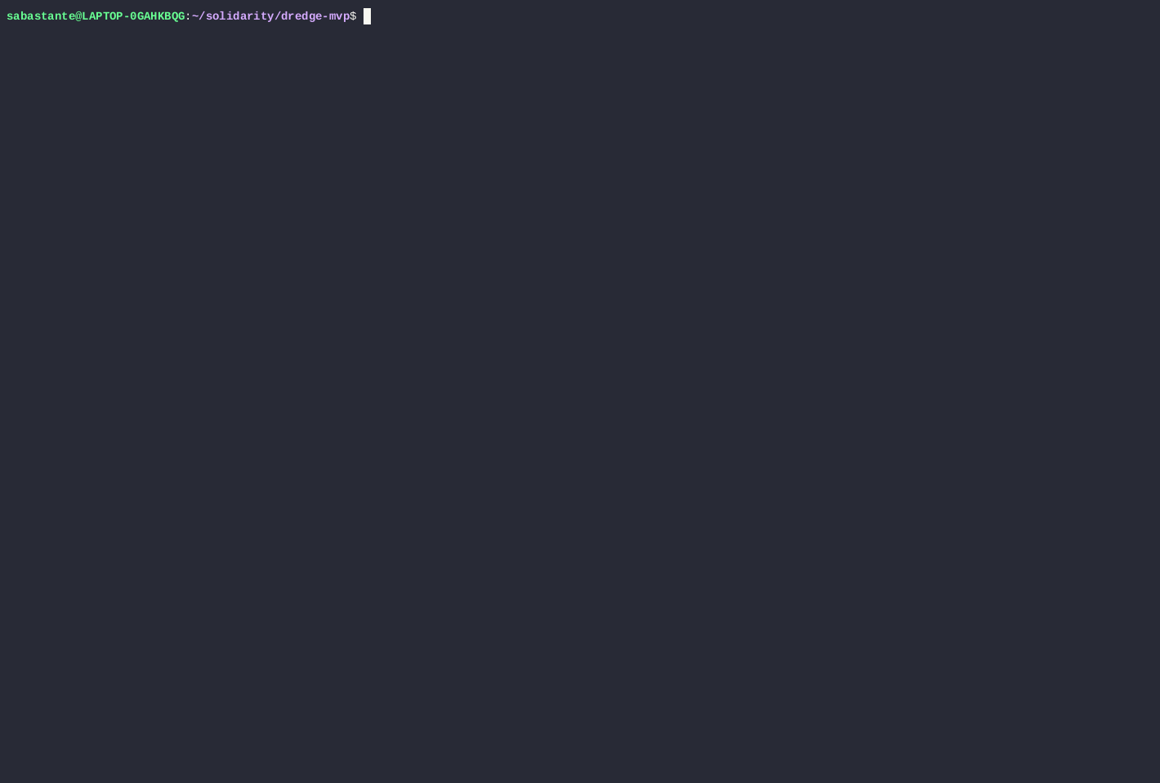

Slide 25
Demo!
Getting Access Keys

Slide 27
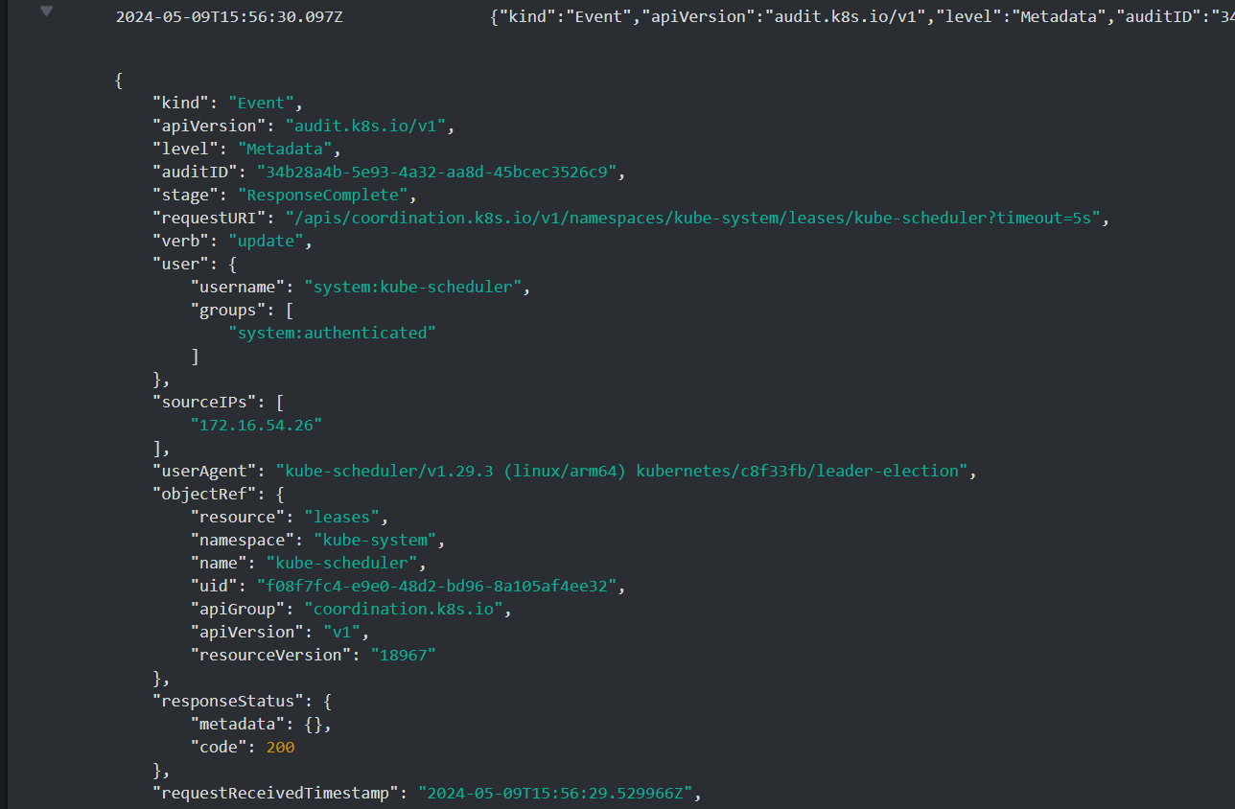
K8s Logs
API Server Logs
Audit Logs
Authenticator
Control Manager
Scheduler

Slide 28
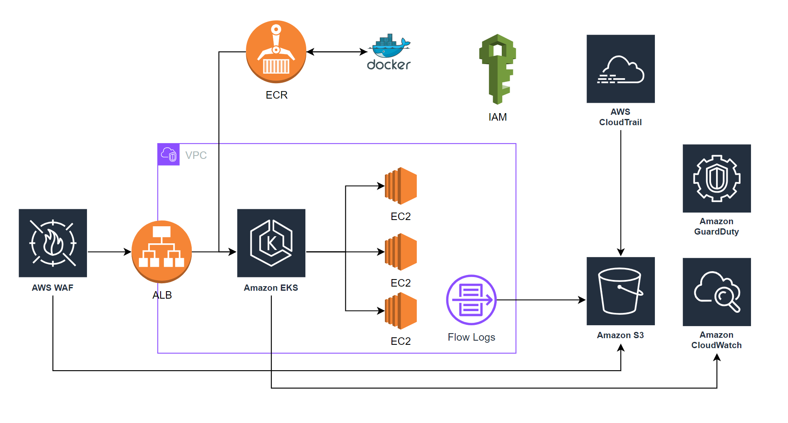
Complete view

Slide 29
The impact!

Slide 30
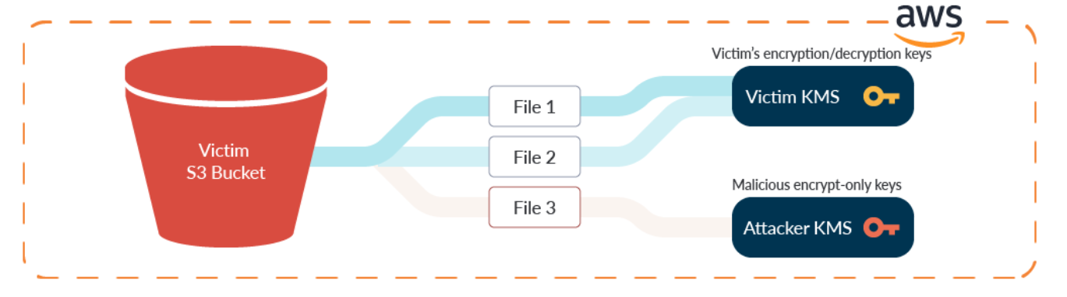
Cloud Ransomware from Within
How it Works:
Access to IAM user Access Keys,
KMS (Encryption Key) creation,
List S3 buckets,
S3 object Download,
Upload new encrypted object and delete the old ones,
Set KMS Key for elimination,
Ransom Note upload,
IAM User deletion.

Slide 31
Demo!
Initial Access and lateral movement in k8s

Slide 32
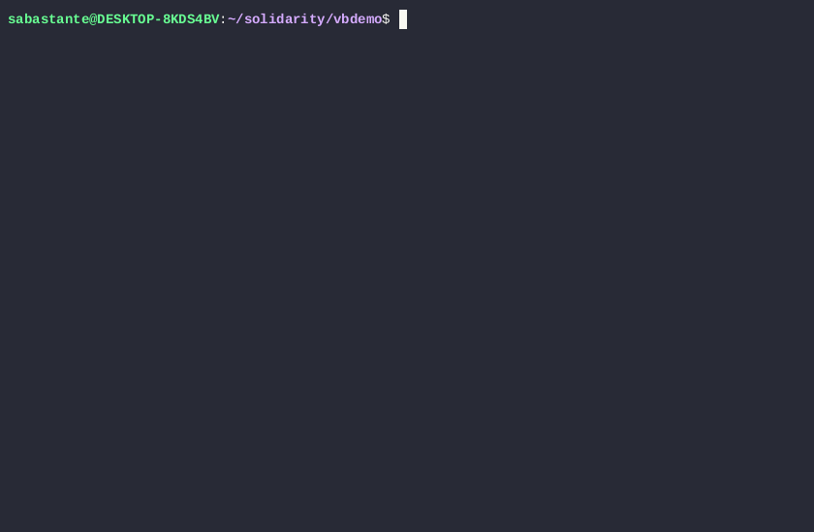

Slide 33
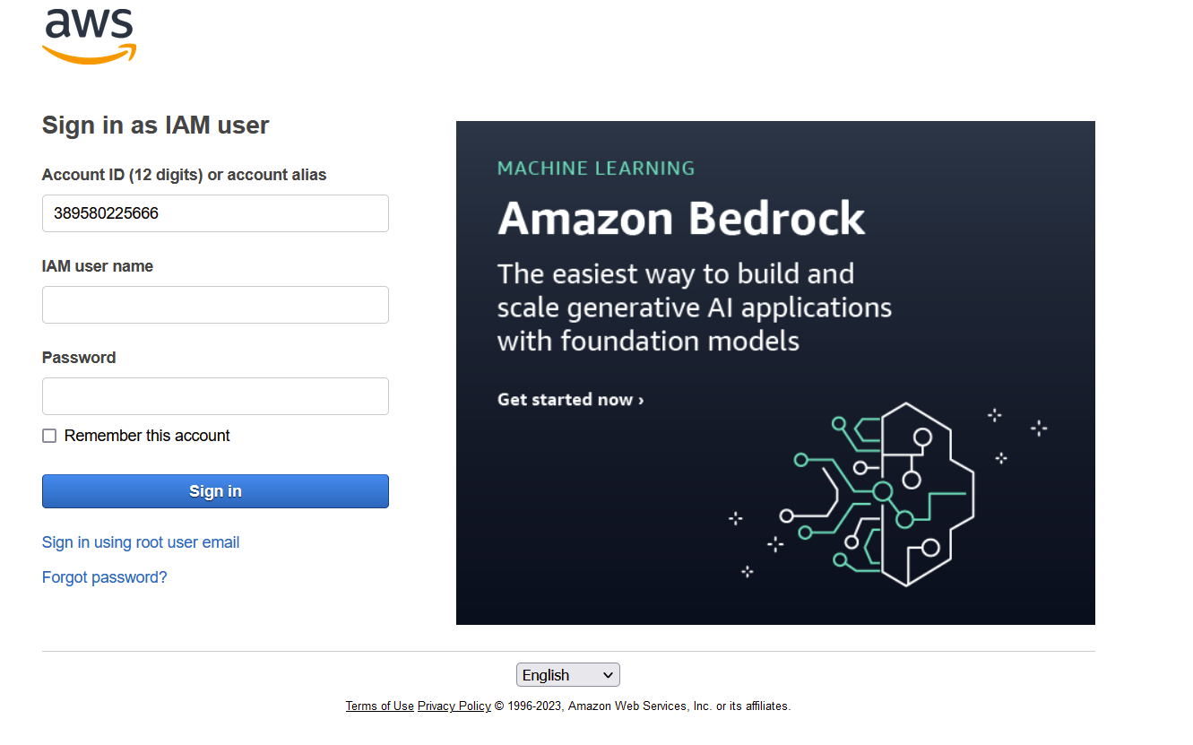
Console Login

Slide 34
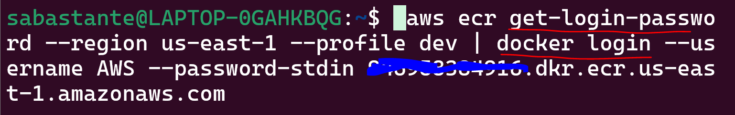
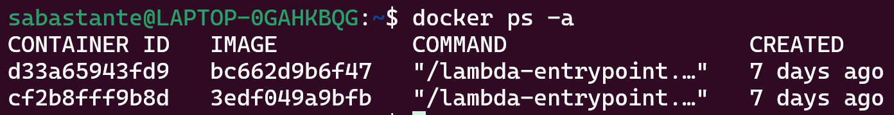
Implant a Docker an Image in ECR

Slide 35
Demo!
k8s authentication

Slide 36


Slide 37
The Response

Slide 38
Demo!
Iam Delete User

Slide 40
Demo!
Getting IPs

Slide 41


Slide 42
Demo!
VT Enrichment

Slide 43
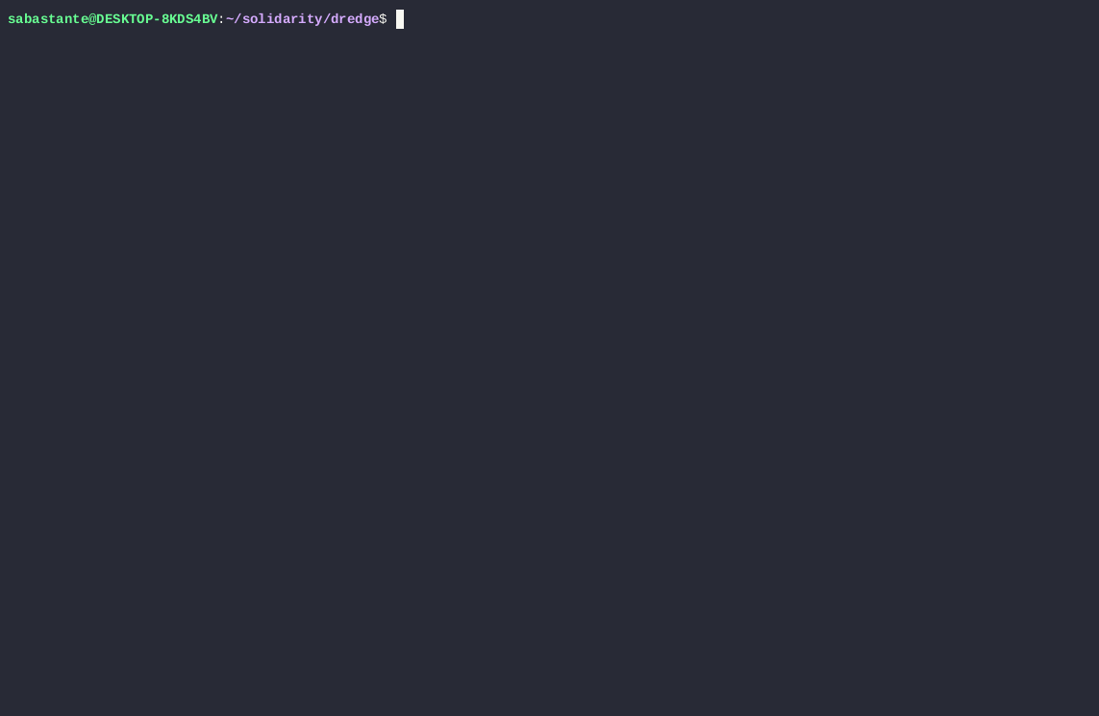

Slide 44
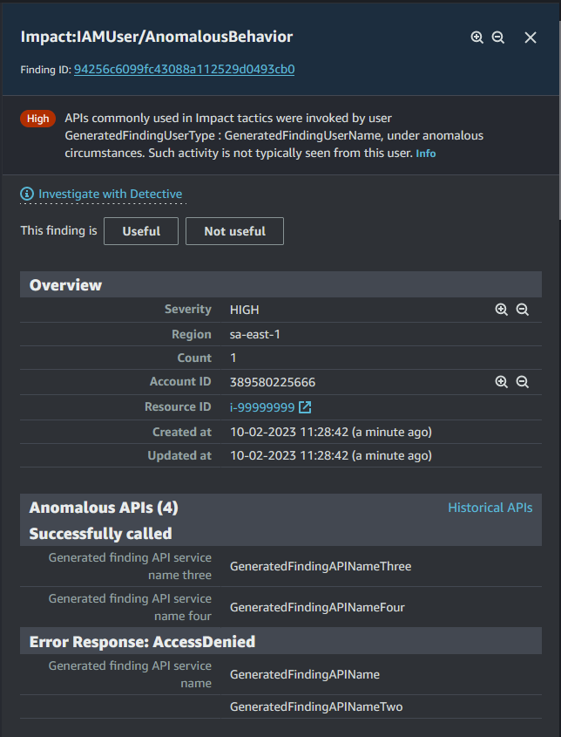
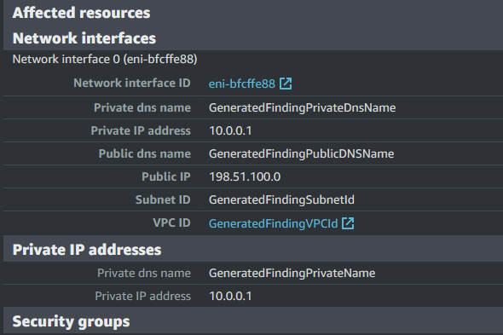
Enabling Security Detection

Slide 45
Demo!
Getting Guradduty Events

Slide 47
Demo!
Disable S3 Public Access

Slide 48
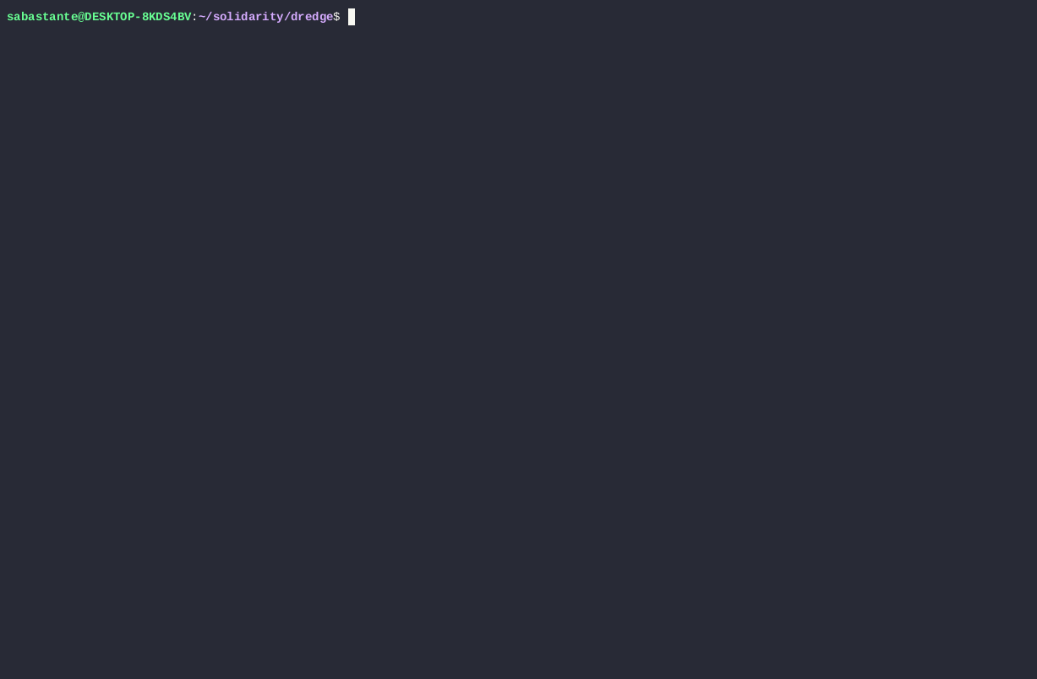

Slide 49
Demo!
Isolate EC2 Instance

Slide 50
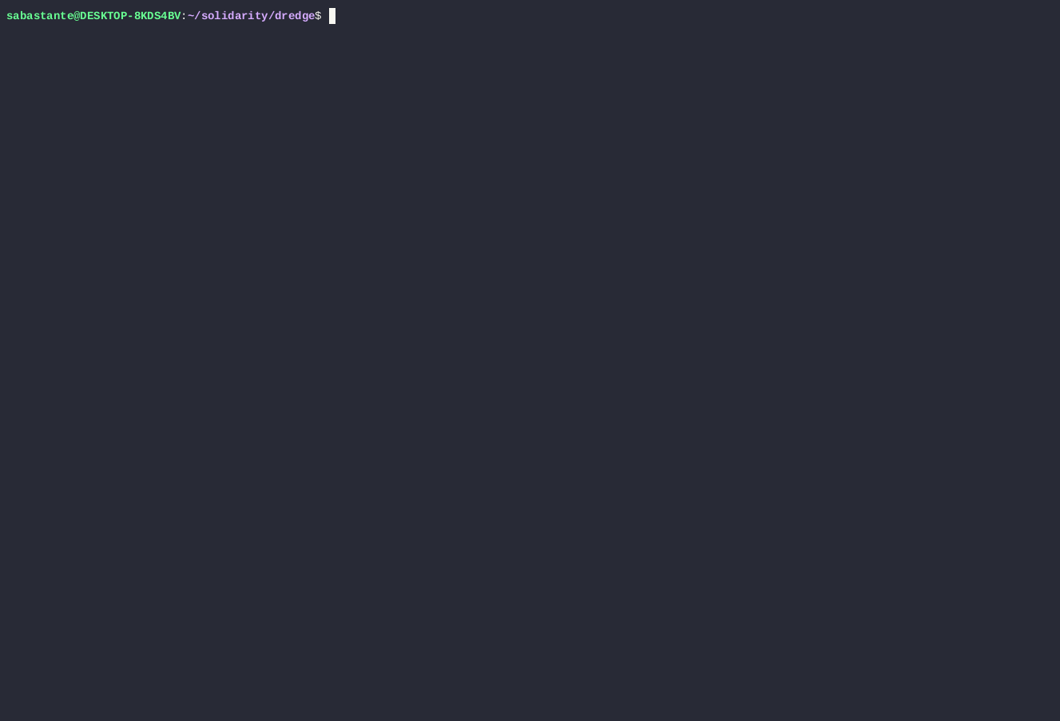

Slide 51
Questions
Download Dredge!

